Slide 1
Sepsis Prediction
Dhruv Patel, Arti Chauhan, Thomas Weldon, Satish Gupta

Slide 2
Introduction and Motivation
Leading cause of decomposition and mortality in US hospitals (approximately 1.7M adults develop sepsis resulting in 270,000 deaths )
we propose to add a clinical prediction benchmark task using data from the Medication Information Mart for Intensive Care (MIMIC-III) to predict, in near real time, the onset of sepsis.
It has been reported that sepsis is frequently underdiagnosed in the hospital despite being mentioned in the discharge notes.
Our Goal is to predict sepsis shock 6 hours before occurrence.

Slide 3
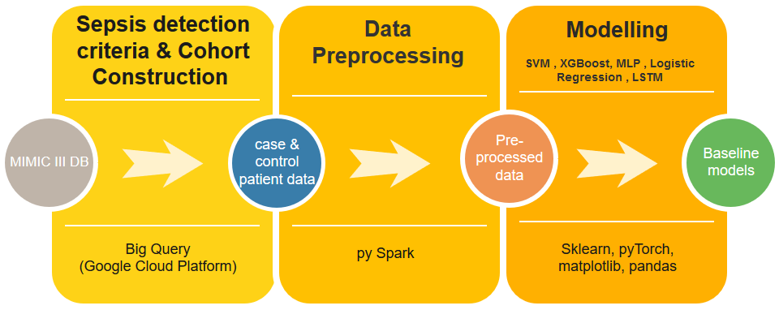
Data Source and Preprocessing
Physionet MIMIC-III dataset
Identify case and control patients
Define observation and prediction window
Feature engineering :
Data cleanup

Slide 4
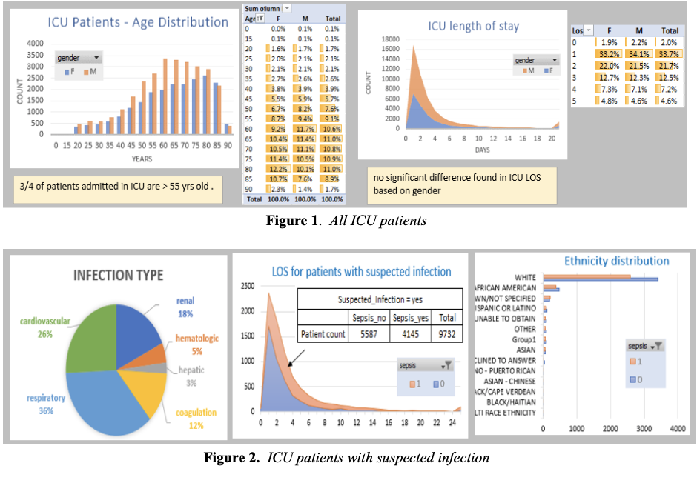
Exploratory Data Analysis

Slide 5
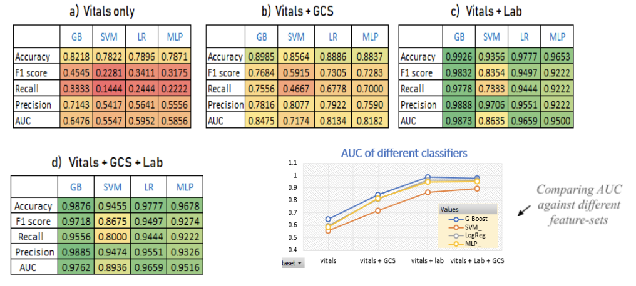
Experimental Results - Baseline Models Balanced Dataset

Slide 6
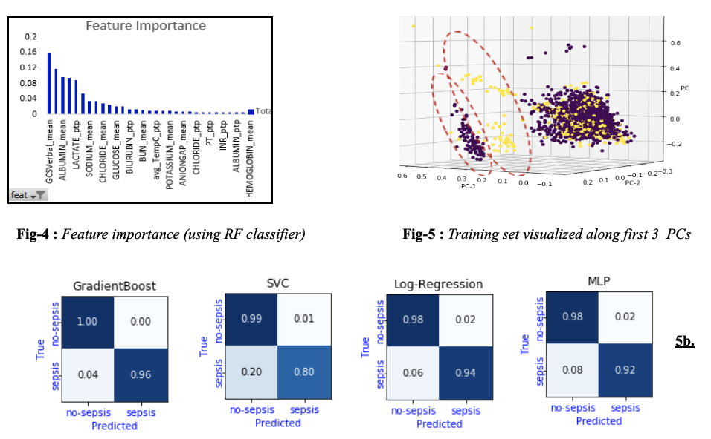
Experimental Results - Baseline Models Balanced Dataset

Slide 7
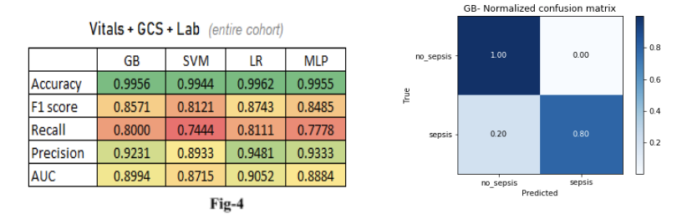
Experimental Results - Baseline Models Imbalance Dataset

Slide 8
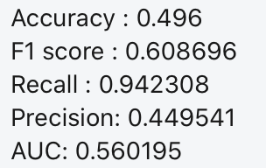
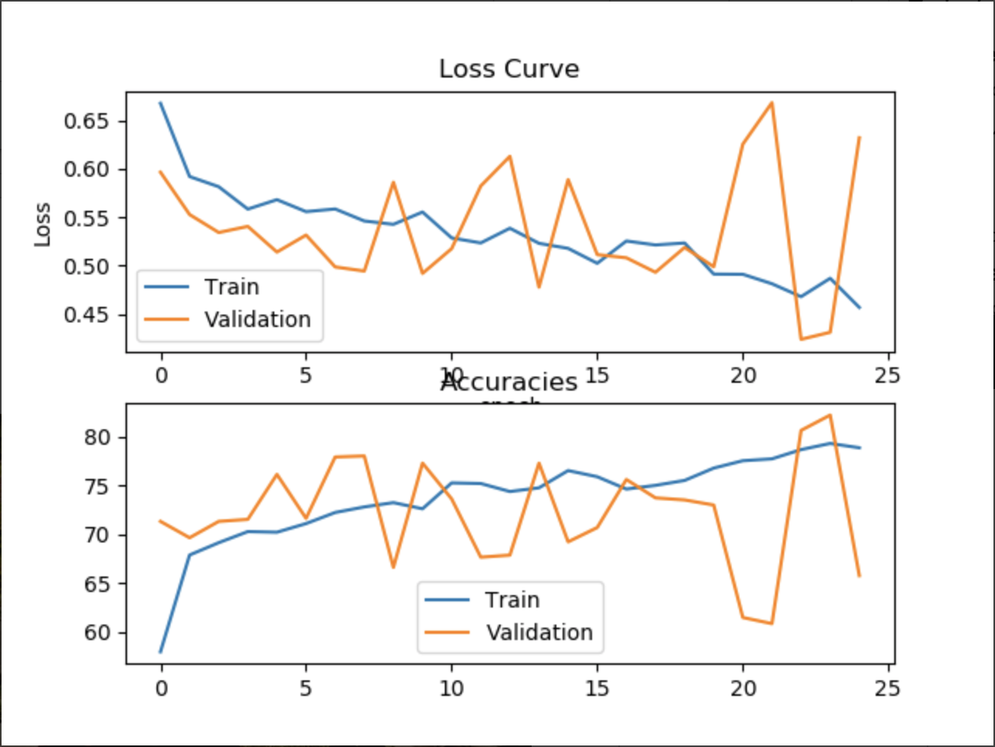
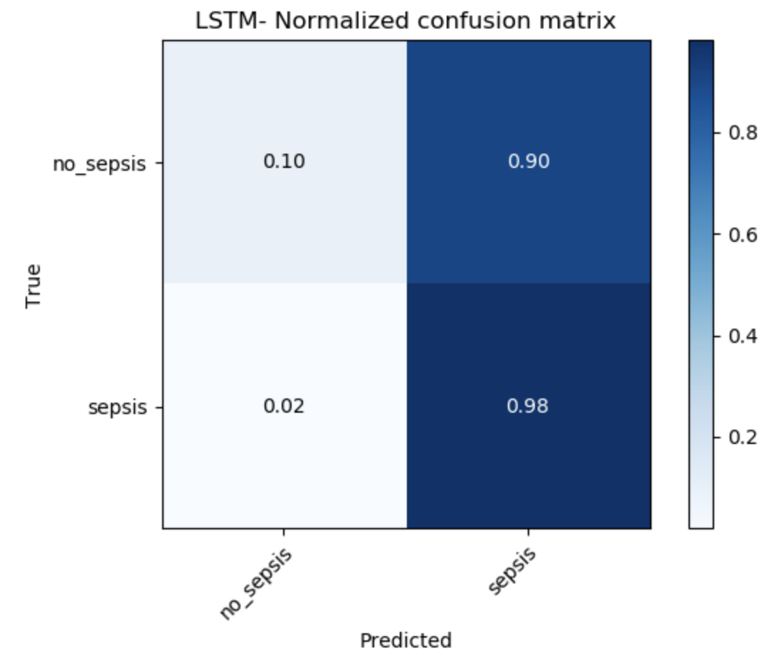
Experimental Results - LSTM Model

Slide 9
Key Takeaways
This study presents a machine-learning based approach to predict sepsis-onset-time using commonly available features such as vitals, GCS and lab-results for ICU patients, without explicitly relying on ICD code.
Study clearly quantifies predictive power of each feature-set. This help with interpretability of model as clinicians can gauge which feature is adding most value and hence can reason about it using their domain knowledge.
This study evaluated robustness of model in presence of imbalanced dataset, which is common is real world setting.

Slide 10
Challenges
Sepsis detection criteria
ETL challenges
Imbalanced Data
Control patient selection
Text Feature extraction
RNN

Slide 11
Future work
Use NLP to extract features from clinical notes.
We can use different ensemble methods
We can use modern deep learning healthcare algorithms
We can consult to physicians and clinical scientist to get better understanding of sepsis prediction
Develop on pre trained model by experts

Slide 12
References
T. Desautels, J. Calvert, J. Hoffman, M. Jay, Y. Kerem, L. Shieh,D. Shimabukuro, U. Chettipally, M. D. Feldman, C. Barton, D. J. Wales, and R. Das. Prediction of sepsis in the intensive care unit with minimal electronic health record data: A machine learning approach. JMIR Med Inform, 4(3):e28, 30 Sept. 2016.
M. Ghassemi, T. Naumann, F. Doshi-Velez, N. Brimmer, R. Joshi, A. Rumshisky, and P. Szolovits. Unfolding Physiological State: Mortality Modelling in Intensive Care Units. In Proceedings of the 20th ACM SIGKDD International Conference on Knowledge Discovery and Data Mining, KDD ’14, pages 75–84, New York, NY, USA, 2014. ACM.
K. E. Henry, D. N. Hager, P. J. Pronovost, and S. Saria. A targeted real-time early warning score (trewscore) for septic shock. Science translational medicine, 7(299):299ra122–299ra122, 2015.
Y. Xu, S. Biswal, S. R. Deshpande, K. O. Maher, and J. Sun. Raim: Recurrent attentive and intensive model of multimodal patient monitoring data. In Proceedings of the 24th ACM SIGKDD International Conference on Knowledge Discovery & Data Mining, pages 2565–2573. ACM, 2018.
S. Nemati, A. Holder, F. Razmi , M.D. Stanley, G.D Clifford GD, T.G Buchman. An Interpretable Machine Learning Model for Accurate Prediction of Sepsis in the ICU. Critical Care Medicine. 46(4):1. December 2017

Slide 13
References
6. Seymour CW, Liu VX, Iwashyna TJ, et al. Assessment of clinical criteria for sepsis: for the third International Consensus definitions for sepsis and septic shock (Sepsis-3). JAMA. 2016;315(8):762-774.
7. Mortality Prediction Model of Septic Shock Patients Based on Routinely Recorded Data- Computational and Mathematical Methods in Medicine Volume 2015, Article ID 761435
8. Singer M, Deutschman CS, Seymour CW, Shankar-Hari M, Annane D, Bauer M, et al. (February 2016). "The Third International Consensus Definitions for Sepsis and Septic Shock (Sepsis-3)". JAMA. 315 (8): 801–10. doi:10.1001/jama.2016.0287. PMC 4968574. PMID 26903338.
9. H. Harutyunyan, H. Khachatrian, D. C. Kale, and A. Galstyan. Multitask learning and benchmarking with clinical time series data. arXiv preprint arXiv:1703.07771, 22 Mar. 2017.

